Slide 1
Dynamic Multi-Faceted Topic Discovery in Twitter
Date : 2013/11/27
Source : CIKM’13
Advisor : Dr.Jia-ling, Koh
Speaker : Wei, Chang

Slide 2
Outline
Introduction
Approach
Experiment
Conclusion

Slide 3
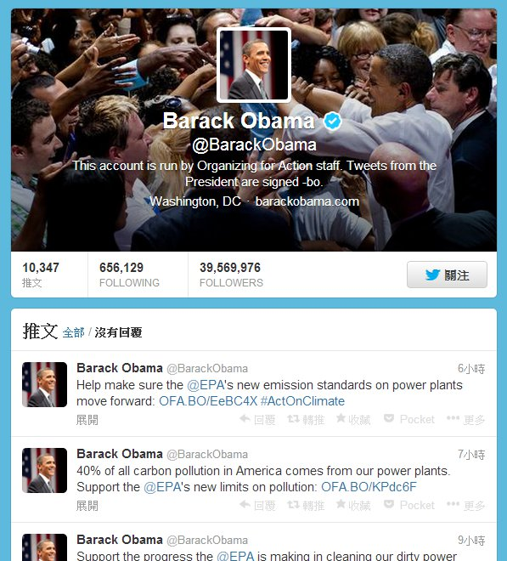
Twitter

Slide 4
What are they talking about?
Entity-centric
High dynamic

Slide 5
Multiple facets of a topic discussed in Twitter

Slide 6
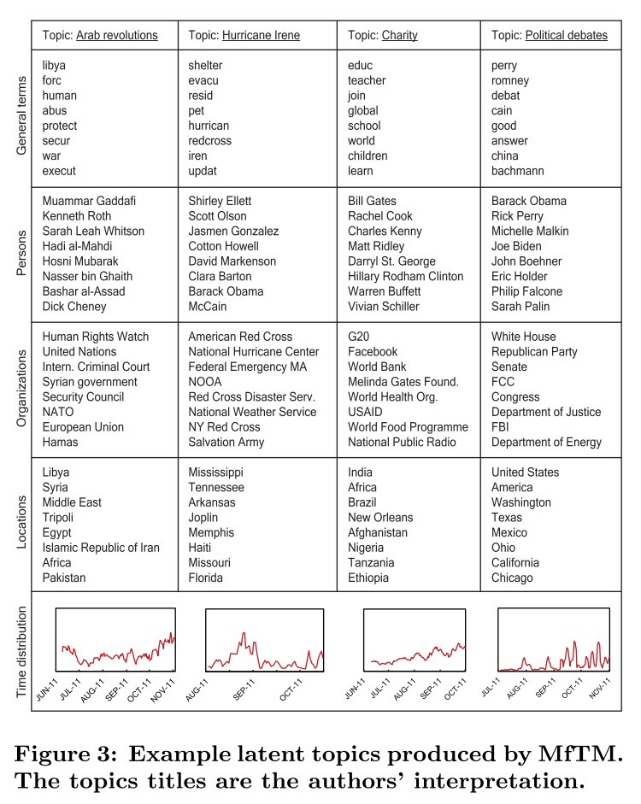
Goal

Slide 7
Outline
Introduction
Approach
Framework
Pre-processing
LDA
MfTM
Experiment
Conclusion

Slide 8
Framework
Twitter
Pre-processing
Training document
Model
(hyper parameter)
Twitter
Pre-processing
Per document
Document
Vector

Slide 9
Pre-processing
Convert to lower-case
Remove punctuation and numbers
“Goooood” to “good”
Remove stop words
Named entity recognition
Entity types : person, organization, location, general terms
Linked Web : http://nlp.stanford.edu/ner/
Tweet : http://github.com/aritter/twitter_nlp
All user’s posts published during the same day are grouped as a document

Slide 10
Latent Dirichlet Allocation
Each document may be viewed as a mixture of various topics.
The topic distribution is assumed to have a Dirichlet prior.
Unsupervised learning
Need to initialize the topic number K
Not Linear discriminant analysis (LDA)

Slide 11
Example
I like to eat broccoli and bananas.
I ate a banana and spinach smoothie for breakfast.
Chinchillas and kittens are cute.
My sister adopted a kitten yesterday.
Look at this cute hamster munching on a piece of broccoli.
Topic 1
: food
Topic 2
: cute animals

Slide 12
How LDA write a document?
munching
chinchillas
broccoli
kittens
breakfast
cute
bananas
hamster

Slide 13
Real World Example

Slide 14
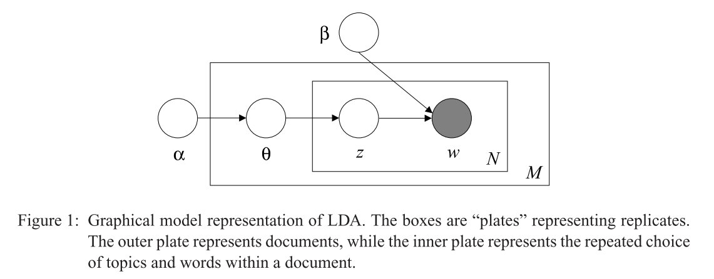
LDA Plate Annotation
$α=\left[\begin{matrix}0.3 \\ 0.7\end{matrix}\right] → θ_{1}=\left[\begin{matrix}0.3 \\ 0.7\end{matrix}\right]$ , $θ_{2}=\left[\begin{matrix}0.1 \\ 0.9\end{matrix}\right]$ ,$θ_{3}=\left[\begin{matrix}0.5 \\ 0.5\end{matrix}\right]$ ,$θ_{4}=\left[\begin{matrix}0.6 \\ 0.5\end{matrix}\right]$ , $θ_{5}=\left[\begin{matrix}0.8 \\ 0.2\end{matrix}\right]$
Different $α$ implies different $θ$ for every document.
Each $θ$ decide the fraction of each topic.
$$β=\left[\begin{matrix}0.7 & 0.2 & 0.1 \\ 0.3 & 0.8 & 0.9\end{matrix} \begin{matrix}0.8 & 0.4 & 0.7 \\ 0.2 & 0.6 & 0.3\end{matrix} \begin{matrix}0.8 & 0.6 \\ 0.2 & 0.4\end{matrix}\right]$$
Different $β$ implies different topic mixture to each word.

Slide 15
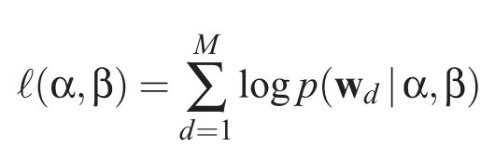
LDA
$$D=\{w_{1},w_{2},w_{3},…,w_{M}\}$$

Slide 16
How to find $α,β$
EM algorithm
Gibbs sampling
Stochastic Variational Inference (SVI)

Slide 17
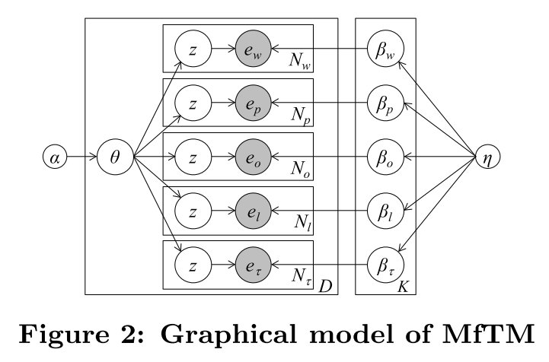
Multi-Faceted Topic Model

Slide 18
Outline
Introduction
Approach
Experiment
Conclusion

Slide 19
Perplexity Evaluation
Perplexity is algebraicly equivalent to the inverse of the geometric mean per-word likelihood.
M is the model learned from the training dataset, ${\vec{w}}_{d}$is the word vector for document d and $N_{d}$ is the number of words in d.

Slide 20
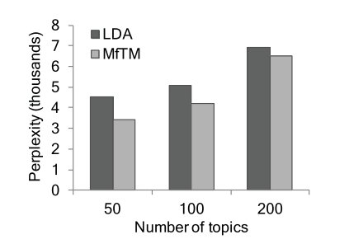
Perplexity Evaluation

Slide 21
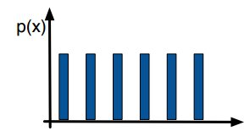
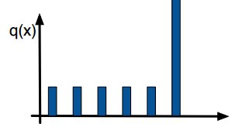
KL-divergence
P={1/6, 1/6, 1/6, 1/6, 1/6, 1/6}
Q={1/10, 1/10, 1/10, 1/10, 1/10, 1/2}
KL is a non-symmetric measure
$D_{KL}(P|\left|Q\right)=\frac{1}{6}ln\left(\frac{\frac{1}{6}}{\frac{1}{10}}\right)+\frac{1}{6}ln\left(\frac{\frac{1}{6}}{\frac{1}{10}}\right)$+$\frac{1}{6}ln\left(\frac{\frac{1}{6}}{\frac{1}{10}}\right)+\frac{1}{6}ln\left(\frac{\frac{1}{6}}{\frac{1}{10}}\right)$+$\frac{1}{6}ln\left(\frac{\frac{1}{6}}{\frac{1}{10}}\right)$+$\frac{1}{6}ln\left(\frac{\frac{1}{6}}{\frac{1}{2}}\right)$

Slide 22
KL-divergence

Slide 23
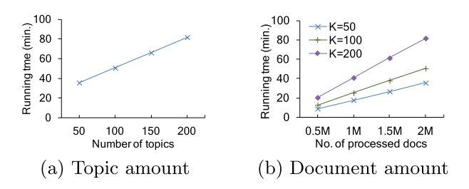
Scalability
A standard PC with a dual-core CPU, 4GB RAM and a 600GB hard-drive

Slide 24
Outline
Introduction
Approach
Experiment
Conclusion

Slide 25
Conclusion
We propose a novel Multi-Faceted Topic Model. The model extracts semantically-rich latent topics, including general terms mentioned in the topic, named entities and a temporal distribution

